Slide 1
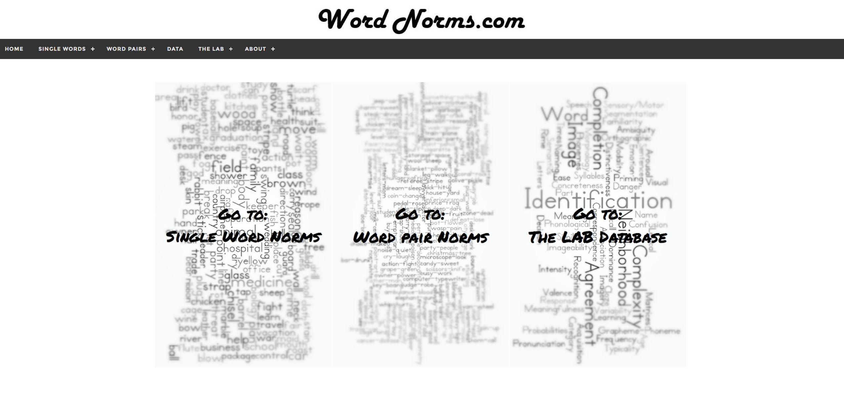
English Semantic Relatedness Norms: An Extended Database, Feature Coding, and Online Website
The DOOM Lab
Missouri State University
Abstract
Linguistic word norms have exploded with the interest in big data and the potential availability of information on the Internet. However, these databases are often limited by time or programming demands on the research team willing to contribute to these norms. This project adds to semantic feature production norms presented in Buchanan et al. (2012), bringing total words normed to over 4000 concepts across existing data.
Results
Convergent Validity
Correlation with other measures of semantics and association
Concept and feature parts of speech, percentages, and average response frequency
 | Root Cosine | Raw Cosine | Affix Cosine | Previous Cosine | JCN | LSA | FSG
Raw | 0.88 | 1
Affix | 0.42 | 0.39 | 1
Previous | 0.89 | 0.83 | 0.42 | 1
JCN | -0.20 | -0.22 | -0.16 | -0.26 | 1
LSA | 0.24 | 0.20 | 0.15 | 0.28 | -0.09 | 1
FSG | 0.09 | 0.07 | 0.07 | 0.16 | -0.16 | 0.26 | 1
BSG | 0.18 | 0.18 | 0.15 | 0.22 | -0.19 | 0.27 | 0.32
Cue Type | Feature Type | % Raw | % Root | M Freq Raw | M Freq Root
Adjective | Adjective | 38.57 | 29.87 | 10.06 (9.95) | 15.87 (12.76)
 | Noun | 39.46 | 46.70 | 7.95 (10.39) | 16.45 (14.33)
 | Verb | 17.59 | 20.62 | 4.63 (5.58) | 13.58 (8.01)
 | Other | 4.37 | 2.82 | 7.43 (7.16) | 14.58 (11.43)
Noun | Adjective | 16.81 | 11.97 | 8.75 (9.96) | 16.10 (13.74)
 | Noun | 60.97 | 62.07 | 9.17 (10.47) | 16.85 (14.46)
 | Verb | 20.31 | 24.31 | 4.58 (5.67) | 13.21 (9.77)
 | Other | 1.91 | 1.66 | 8.20 (8.11) | 15.33 (11.62)
Verb | Adjective | 19.18 | 20.34 | 10.70 (11.02) | 15.19 (12.80)
 | Noun | 42.45 | 37.32 | 10.75 (13.62) | 14.90 (13.48)
 | Verb | 19.92 | 24.11 | 4.06 (4.58) | 10.59 (7.95)
Other | Other | 18.45 | 18.24 | 13.43 (11.35) | 15.30 (13.44)
 | Adjective | 14.90 | 12.14 | 7.45 (8.48) | 17.02 (12.87)
 | Noun | 43.01 | 42.84 | 7.86 (9.55) | 21.72 (18.89)
 | Verb | 36.78 | 41.01 | 6.33 (8.20) | 16.88 (11.35)
 | Other | 5.31 | 4.02 | 8.29 (7.79) | 15.90 (13.00)
Method
Participants
 | University of Mississippi | Missouri State University | Montana State University | Mechanical Turk | Mechanical Turk 2
Total Participants | 749 | 1420 | 127 | 571 | 198
Concepts | 658 | 720 | 120 | 310 | 1914
Mean N | 67.8 | 71.4 | 63.5 | 60 | 30
Stepwise Regression using length, frequency, association, and semantics predicting the Z difference score from the Semantic Priming Project
Predictor Values for each variable split by type of priming pair
 | LDT 200 ms Z-Priming |  | LDT 1200 ms Z-Priming
Variables | First Associate | Other Associate | First Associate | Other Associate
Target Frequency | -0.02 | -0.02 | -0.06 | -0.02
Target Length |  |  | -0.01 | 0.01
FSG |  |  | 0.06
BSG | 0.27 | 0.24 | 0.16
LSA | 0.09 | 0.19 | 0.07 | 0.12
JCN
Root | 0.05 | 0.08 | 0.08
Raw |  |  |  | 0.25
Affix |  |  |  | -0.22
N | 1277 | 1249 | 1277 | 1249
R² | 0.04 | 0.03 | 0.04 | 0.02
F | (4, 1272) = 12.91 p < .001 | (4, 1244) = 9.19 p < .001 | (6, 1270) = 9.83 p < .001 | (5,1243) = 5.04 p < .001
Stimuli
3,722 concepts taken from Nelson et al. norms, Semantic Priming Project, and matched to other semantic feature production norms
67.57% nouns, 17.65 adjectives, 12.06 verbs, 2.71 other types
Average numbers of features for each type of concept and data location.
Tag examples and percent by cue
n=55
Affix Tag | Example | Percent
Actions/Processes | ion, ment, ble, ate, ize | 7.59
Characteristic | y, ous, nt, ful, ive, wise, nce, ish | 18.15
Location | under, sub, mid, inter | 0.35
Magnitude | er, est, over, super, extra | 1.24
Not | less, dis, un, non, in, im, ab | 2.57
Number | s, uni, bi, tri, semi | 24.71
Opposites/Wrong | mis, anti, de | 0.14
Past Tense | ed | 7.10
Person/Object | er, or, men, person, ess, ist | 5.81
Present Participle | ing | 12.60
Third Person | s | 5.70
Time | fore, pre, post, re | 0.53
 | University of Mississippi | Missouri State University | Montana State University | Mechanical Turk | Mechanical Turk 2 | Total
Adjective | 6.28 (3.30) | 8.05 (4.15) | 7.78 (3.40) | 8.70 (3.89) | 6.98 (1.42) | 7.24 (2.92)
Noun | 9.14 (5.67) | 9.73 (4.47) | 10.15 (4.68) | 10.68 (5.49) | 8.35 (1.79) | 9.04 (3.79)
Verb | 7.86 (4.00) | 10.28 (6.20) | 8.01 (3.82) | 7.44 (2.82) | 7.63 (1.68) | 7.80 (2.95)
Other | 6.17 (3.41) | 9.95 (4.72) | 7.63 (2.66) | 7.71 (2.28) | 7.39 (1.91) | 7.29 (2.77)
Total | 8.22 (5.11) | 9.41 (4.58) | 9.28 (4.40) | 9.84 (5.02) | 8.06 (1.80) | 8.96 (4.18)
Website
Website includes the following for download:
Cue-feature-root lists with frequency, part of speech, affix tags, and association
Cosine pairs from previous work paired with association and other semantic variables
Database search
n=206
Divergent Validity
Data were compared Nelson et al. association norms for low overlap and low forward strength (FSG) and backward strength (BSG) values. This data was split by the listed feature and root word for each feature.
Procedure
This experiment is part of an investigation into how people read words for meaning. To help us conduct this work, we need information on what people know about different things in the world. Please fill in as many properties of the concept that you can think of to which the word refers. Examples of different types of properties would be: physical properties, such as internal and external parts, and how it looks, sounds, smells, feels, or tastes; functional properties, such as what it is used for; where, when and by whom it is used; things that the concept is related to, such as the category that it belongs in; and other facts, such as how it behaves, or where it comes from.
Data Processing
Inappropriate entries were removed (Wikipedia, “I don’t know”, etc.).
All individual feature frequencies were tabulated.
The top five features or features with at least 16% mentions were kept.
Root words were labeled, and we coded affix types for each feature.
 | Percent Overlap | M FSG | SD FSG | M BSG | SD BSG
Adjective | 3.30 | 0.12 | 0.15 | 0.07 | 0.15
Noun | 18.25 | 0.11 | 0.14 | 0.04 | 0.11
Other | 0.42 | 0.14 | 0.18 | 0.11 | 0.20
Verb | 3.15 | 0.11 | 0.14 | 0.06 | 0.13
Total Feature | 25.12 | 0.11 | 0.14 | 0.05 | 0.12
Adjective | 4.29 | 0.12 | 0.15 | 0.06 | 0.13
Noun | 26.69 | 0.12 | 0.14 | 0.04 | 0.10
Other | 0.63 | 0.13 | 0.17 | 0.10 | 0.18
Verb | 4.45 | 0.12 | 0.14 | 0.06 | 0.13
Total Root | 36.06 | 0.12 | 0.14 | 0.05 | 0.11
Contact: Dr. Erin M Buchanan (erinbuchanan@missouristate.edu)

